Slide 1
Lecture 2d
Latent variable models

Slide 2
Overview
Principal Component Analysis (PCA)
Probabilistic PCA
Independent component analysis (ICA)

Slide 3

Latent variables
Sometimes data depends on the variables we can not measure (hard to measure)
Answers on the test depend on Intelligence
Brain activity in the brain is measured by sensors
Stock prices depend on market confidence
X
Z
Source: Leadliaison.com

Slide 4
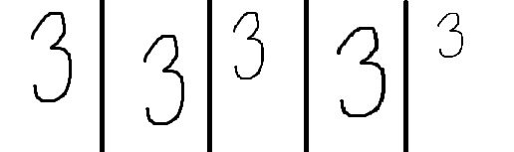
Latent variables
Latent factor discovered→ data storage may decrease a lot
Latent factors
Center
Scaling
Original vs compressed
100x100x5=50000
100x100+2*5+2*5=10020

Slide 5
Principal Component Analysis (PCA)
PCA is a technique for reducing the complexity of high dimensional data
It can be used to approximate high dimensional data with a few dimensions (latent features) –> much less data to store
New variables might have a special interpretation
Applications
Image recognition
Information compression
Subspace clustering
…

Slide 6
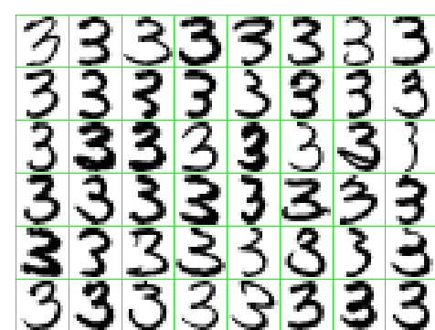
Principal Component Analysis (PCA)
Example 1: Hadwritten digits
Can we get a more compact summary?

Slide 7
Absorbance records for ten samples of chopped meat
Parallel coordinate plot for “FAT”
1 target (fat)
100 features (absorbance at 100 wavelengths or channels)
The features are strongly correlated to each other

Slide 8
Principal components analysis
Idea: Introduce a new coordinate system (PC1, PC2, …) where
The first principal component (PC1) is the direction that maximizes the variance of the projected data
The second principal component (PC2) is the direction that maximizes the variance of the projected data after the variation along PC1 has been removed
The third principal component (PC3) is the direction that maximizes the variance of the projected data after the variation along PC1 and PC2 has been removed
….
In the new coordinate system, coordinates corresponding to the last principal components are very small → can take away these columns

Slide 9
Principal Component Analysis - two inputs
PC1
PC2

Slide 10
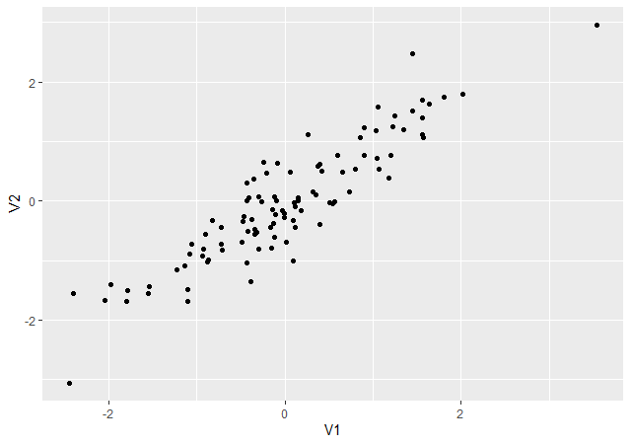
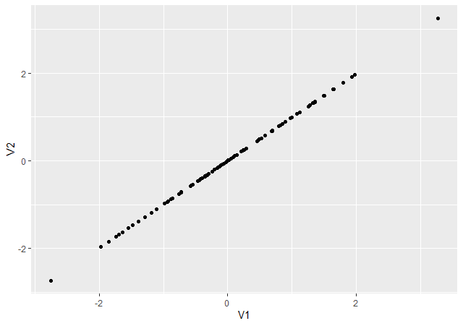

PCA- after reducing dimensionality
Data became approximate (but less data to store)
$PC_{1},…PC_{M}$ are actually eigenvections of sample covariance (first largest eigenvalue,…,Mth largest egenvalue)
Original data
After compression

Slide 11
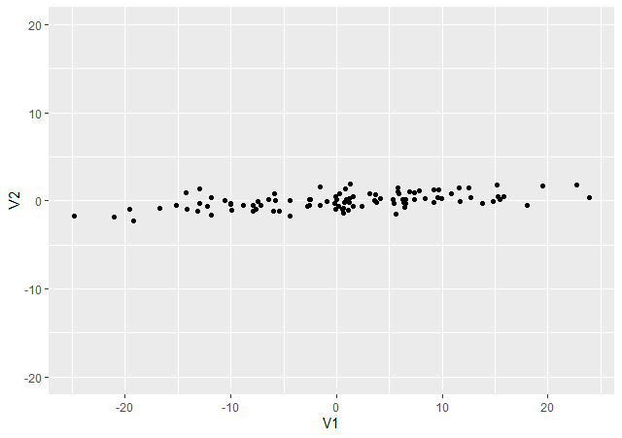
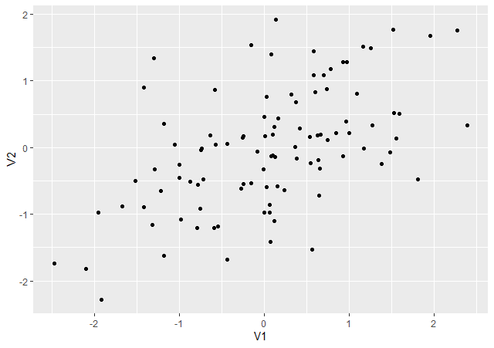
PCA and scaling
Do we need to scale features?
Without scaling
After scaling

Slide 12
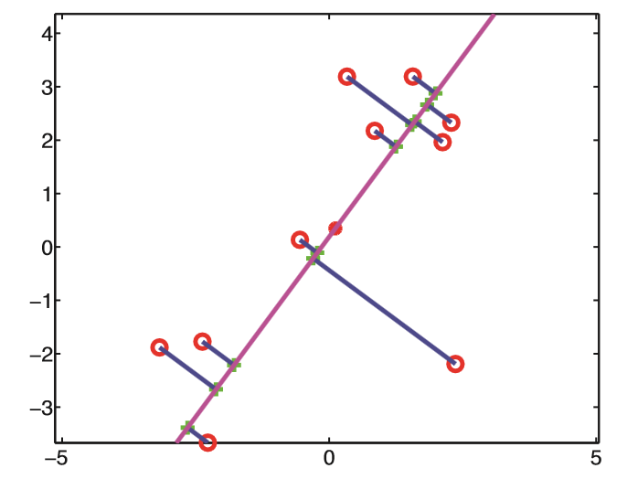

PCA: another view
Aim: minimize the distance between the original and projected data
$$\min_{U_{M}}{\sum_{i=1}^{N}{{\left\|x_{n}−{\tilde{x}}_{n}\right\|}^{2}}}$$
Source: Murphy

Slide 13
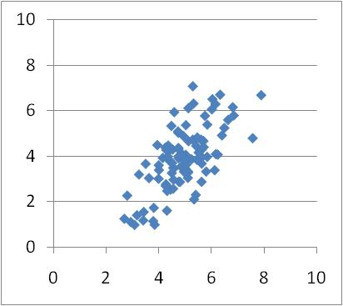
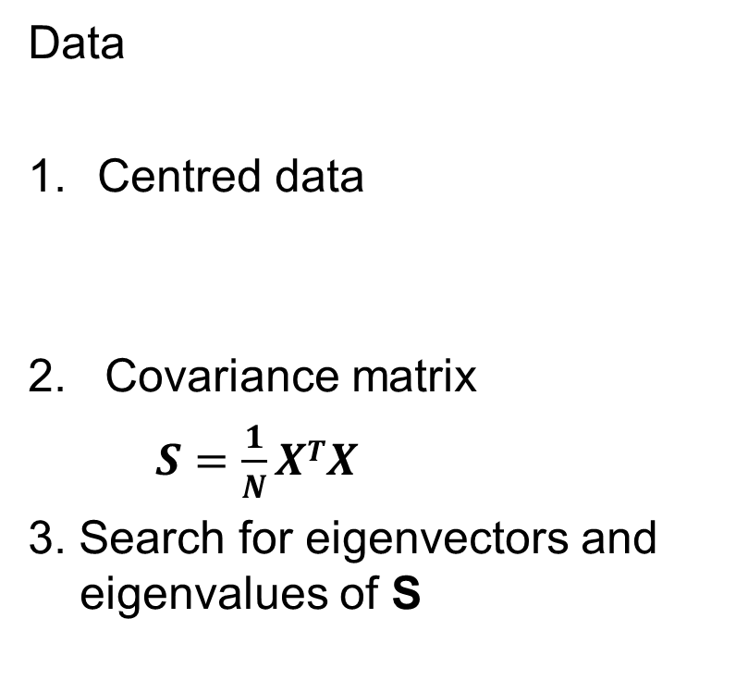
PCA: computations
Data
Centred data
2. Covariance matrix
$S=\frac{1}{N}XTX$
3. Search for eigenvectors and eigenvalues of S

Slide 14
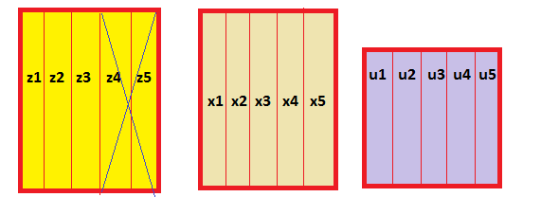
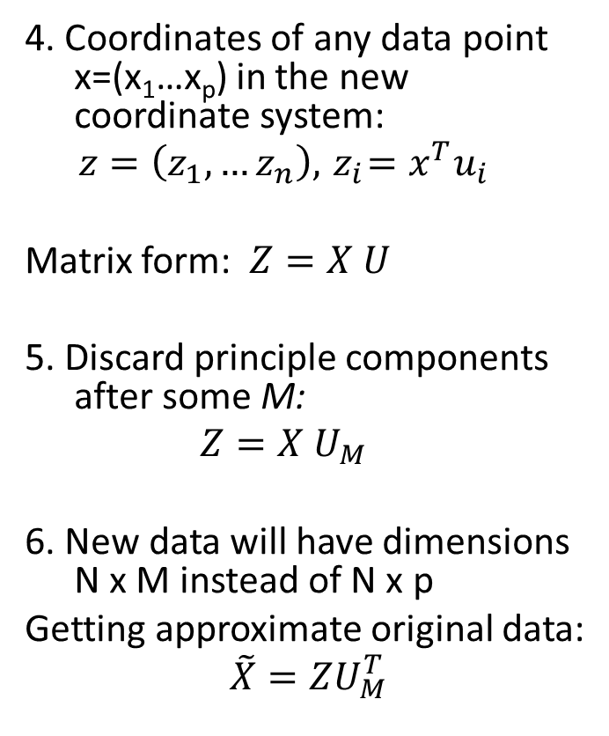
PCA: computations
4. Coordinates of any data point x=(x₁…x_{p}) in the new coordinate system:
$$z=\left(z_{1},…z_{n}\right),{ z}_{i}=x^{T}u_{i}$$
Matrix form: $Z=X U$
5. Discard principle components after some M:
$$Z=X U_{M}$$
6. New data will have dimensions N x M instead of N x p
Getting approximate original data:
$$\tilde{X}=ZU_{M}^{T}$$
Store: N x M+ p x M
instead N x p
100*50 vs 100*4+50*4

Slide 15
















PCA: computations
PCA makes a linear compression of features
$${ x}_{1}$$
$${ \tilde{x}}_{1}$$
$${ x}_{2}$$
$${ z}_{1}$$
$${ \tilde{x}}_{2}$$
$${ x}_{3}$$
$$z=x^{T}⋅U_{M}$$
$${ z}_{2}$$
$$\tilde{x}=z^{T}⋅U_{M}^{T}$$
$${ \tilde{x}}_{3}$$
$${ x}_{4}$$
$${ \tilde{x}}_{4}$$
$$R^{p}$$
$$R^{M}, M<p$$
$$R^{p}$$
$$\min_{U_{M}}{\sum_{i=1}^{N}{{\left\|x_{n}−{\tilde{x}}_{n}\right\|}^{2}}}$$

Slide 16
Principal Component Analysis
Eigenanalysis of the Covariance Matrix
Eigenvalue 2.8162 0.3835
Proportion 0.880 0.120
Cumulative 0.880 1.000
Variable PC1 PC2
X1 0.523 0.852
X2 0.852 -0.523
PC1
PC2
Loadings (U)

Slide 17
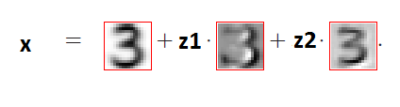
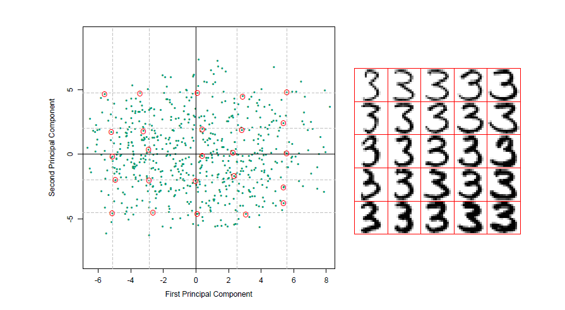
Principal Component Analysis
Digits: two eigenvectors extracted
Interptretation of eigenvectiors
Lower tail length
thickness

Slide 18
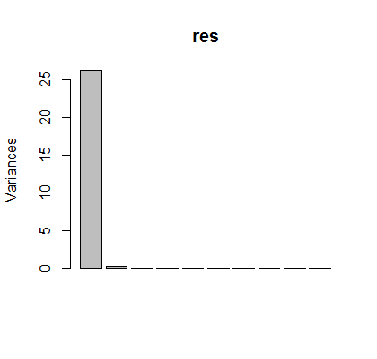


PCA in R
Prcomp(), biplot(), screeplot()
mydata=read.csv2("tecator.csv")
data1=mydata
data1$Fat=c()
res=prcomp(data1)
lambda=res$sdev^2
#eigenvalues
lambda
#proportion of variation
sprintf("%2.3f",lambda/sum(lambda)*100)
screeplot(res)
Only 1 component captures the 99% of variation!

Slide 19
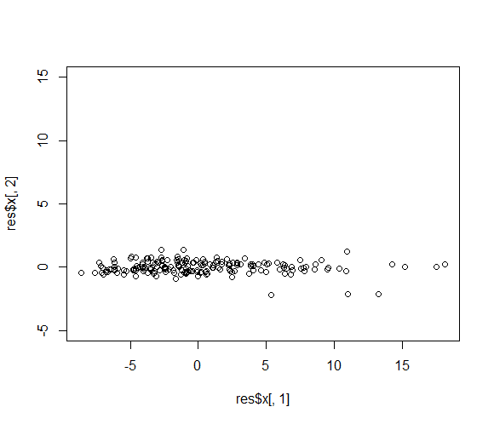
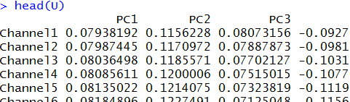
PCA in R
Principal component loadings (U)
Data in (PC1, PC2) – scores (Z)
U=res$rotation
head(U)
plot(res$x[,1], res$x[,2], ylim=c(-5,15))
Do we need second dimension?

Slide 20
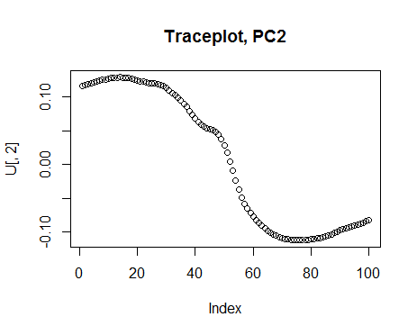
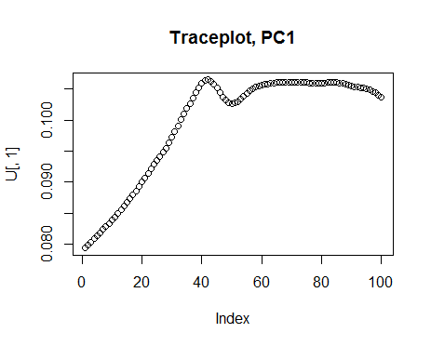
PCA in R
Trace plots
U= res$rotation
plot(U[,1], main="Traceplot, PC1")
plot(U[,2],main="Traceplot, PC2")
Which components contribute to PC1-2?

Slide 21
Absorbance records for ten samples of chopped meat
PCA2 captures the most of remaining variation
High fat
samples
Low fat
samples

Slide 22
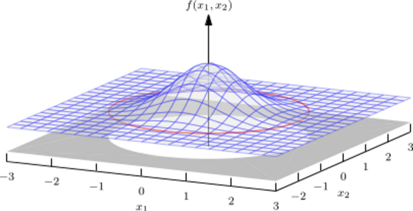
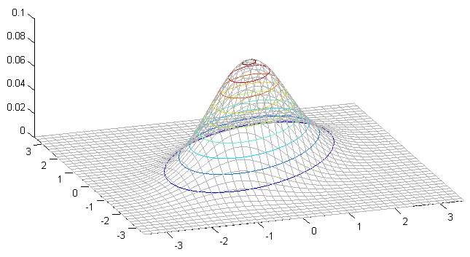
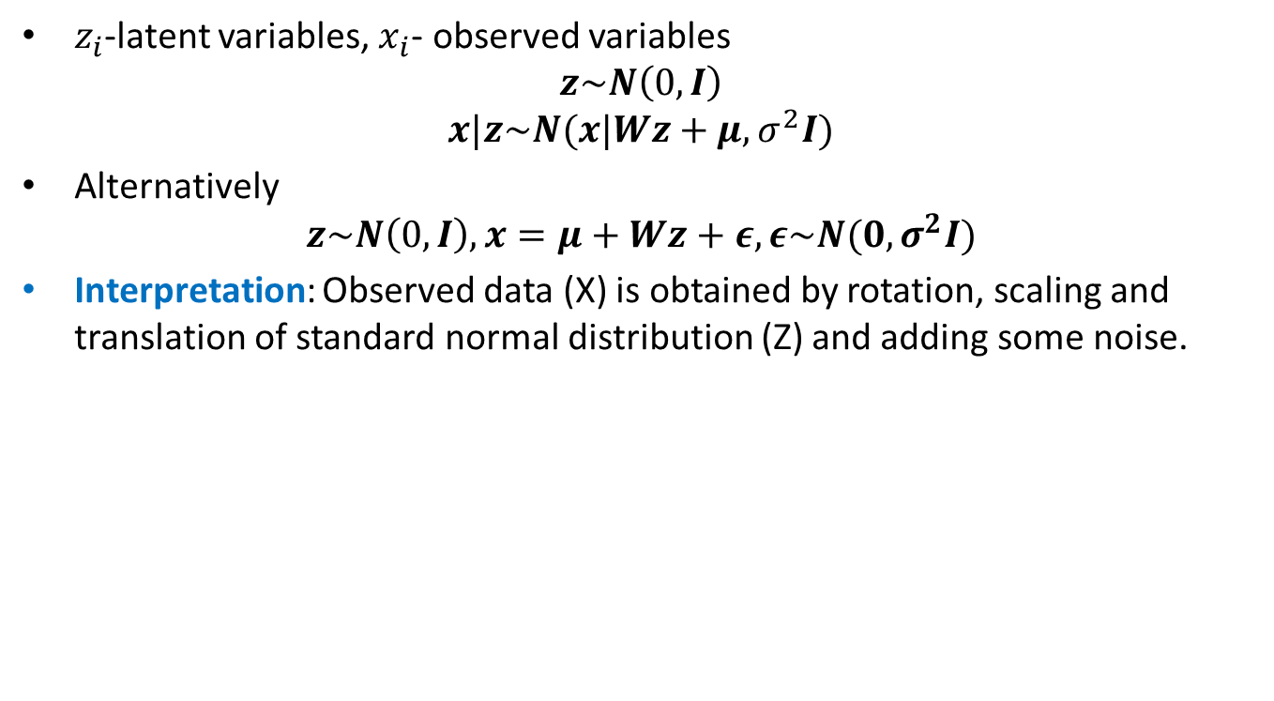
Probabilistic PCA
$z_{i}$-latent variables, $x_{i}$- observed variables
$$z\sim N\left(0,I\right)$$
$$x|z\sim N(x|Wz+μ, σ^{2}I)$$
Alternatively
$$z\sim N\left(0,I\right),x=μ+Wz+ε, ε\sim N(0, σ^{2}I)$$
Interpretation: Observed data (X) is obtained by rotation, scaling and translation of standard normal distribution (Z) and adding some noise.
X
Z
Z
X

Slide 23
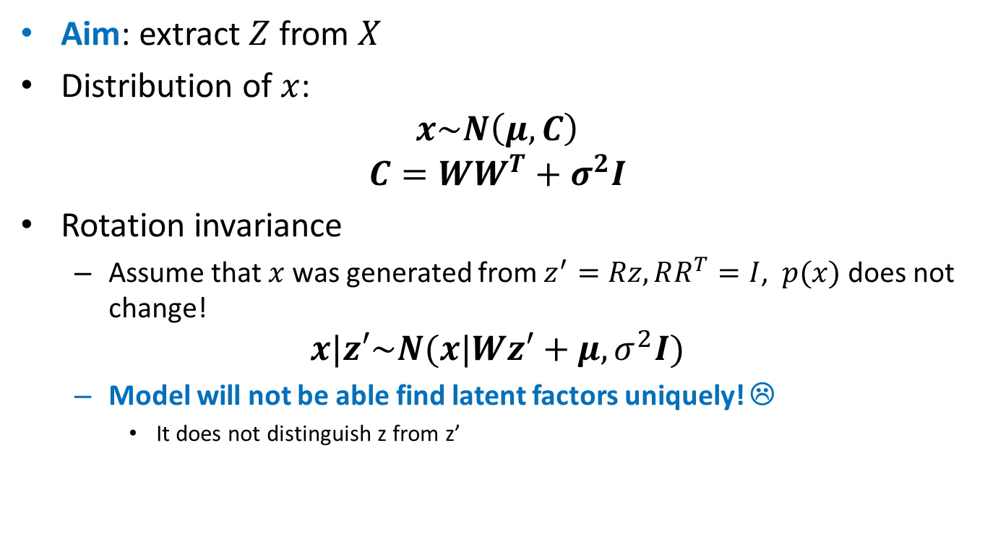
Probabilistic PCA
Aim: extract $Z$ from $X$
Distribution of $x$:
$$x\sim N\left(μ,C\right)$$
$$C=WW^{T}+σ^{2}I$$
Rotation invariance
Assume that $x$ was generated from $z^{′}=Rz, RR^{T}=I$, $p(x)$ does not change!
$$x|z′\sim N(x|Wz′+μ, σ^{2}I)$$
Model will not be able find latent factors uniquely! ☹
It does not distinguish z from z’

Slide 24
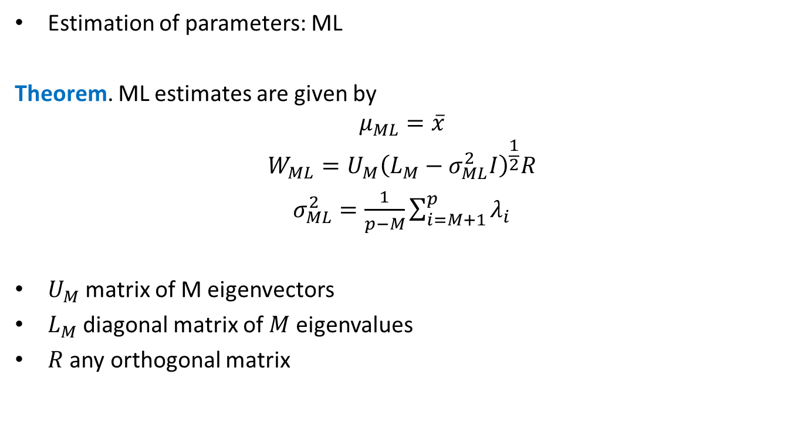
Probabilistic PCA
Estimation of parameters: ML
Theorem. ML estimates are given by
$$μ_{ML}=\overline{x}$$
$$W_{ML}=U_{M}{\left(L_{M}−σ_{ML}^{2}I\right)}^{\frac{1}{2}}R$$
$σ_{ML}^{2}=\frac{1}{p−M}\sum_{i=M+1}^{p}{λ_{i}}$
$U_{M}$ matrix of M eigenvectors
$L_{M}$ diagonal matrix of $M$ eigenvalues
$R$ any orthogonal matrix

Slide 25
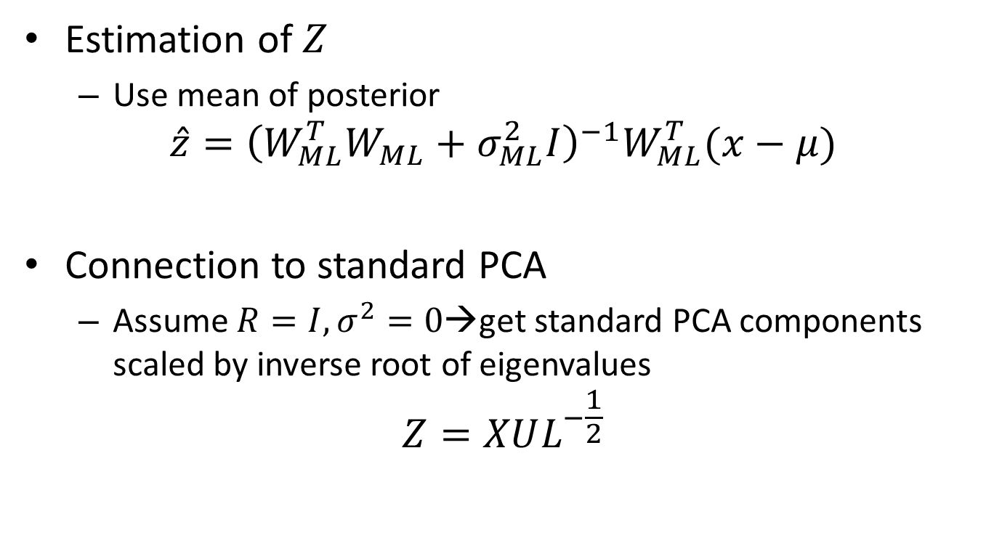
Probabilistic PCA
Estimation of $Z$
Use mean of posterior
$$\hat{z}={\left(W_{ML}^{T}W_{ML}+σ_{ML}^{2}I\right)}^{−1}W_{ML}^{T}(x−μ)$$
Connection to standard PCA
Assume $R=I, σ^{2}=0$→get standard PCA components scaled by inverse root of eigenvalues
$$Z=XUL^{−\frac{1}{2}}$$
Notes:
{

Slide 26
Advantages of probabilistic PCA
More settings to specify→ more flexible
Can be faster when M<<p
Missing values can be handled
M can be derived if a Bayesian version is used
Probabilistic PCA can be applied to classification problems directly
Probabilistic PCA can generate new data

Slide 27
Probabilistic PCA in R
Use pcaMethods from Bioconductor
Install
source("https://bioconductor.org/biocLite.R")
biocLite("pcaMethods")
Ppca(data, nPcs,…)
Results: scores, loadings…

Slide 28
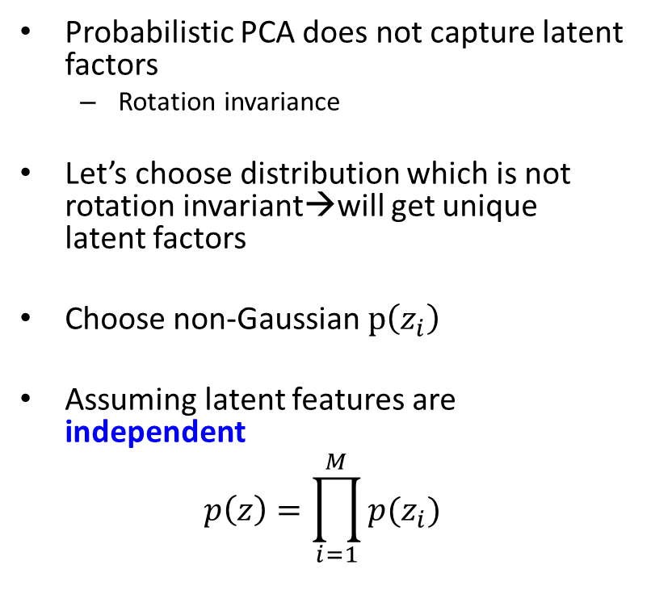

Independent component analysis (ICA)
Probabilistic PCA does not capture latent factors
Rotation invariance
Let’s choose distribution which is not rotation invariant→will get unique latent factors
Choose non-Gaussian $p\left(z_{i}\right)$
Assuming latent features are independent
$$p\left(z\right)=\prod_{i=1}^{M}{p(z_{i})}$$
$$p\left(z_{i}\right)=\frac{2}{π(e^{z_{i}}+e^{−z_{i}})}$$

Slide 29

ICA
Model
$$x=μ+Wz+ε, ε\sim N\left(0, Σ\right)$$
Estimation : Maximum likelihood ($V=W^{−1}$)
Assuming noise-free x
$$\max_{V}{\sum_{i=1}^{n}{\sum_{j=1}^{p}{\log\left(p_{j}\left(v_{j}^{T}x_{i}\right)\right)}} }$$
Subject to $\left|\left|v_{i}\right|\right|=1$

Slide 30
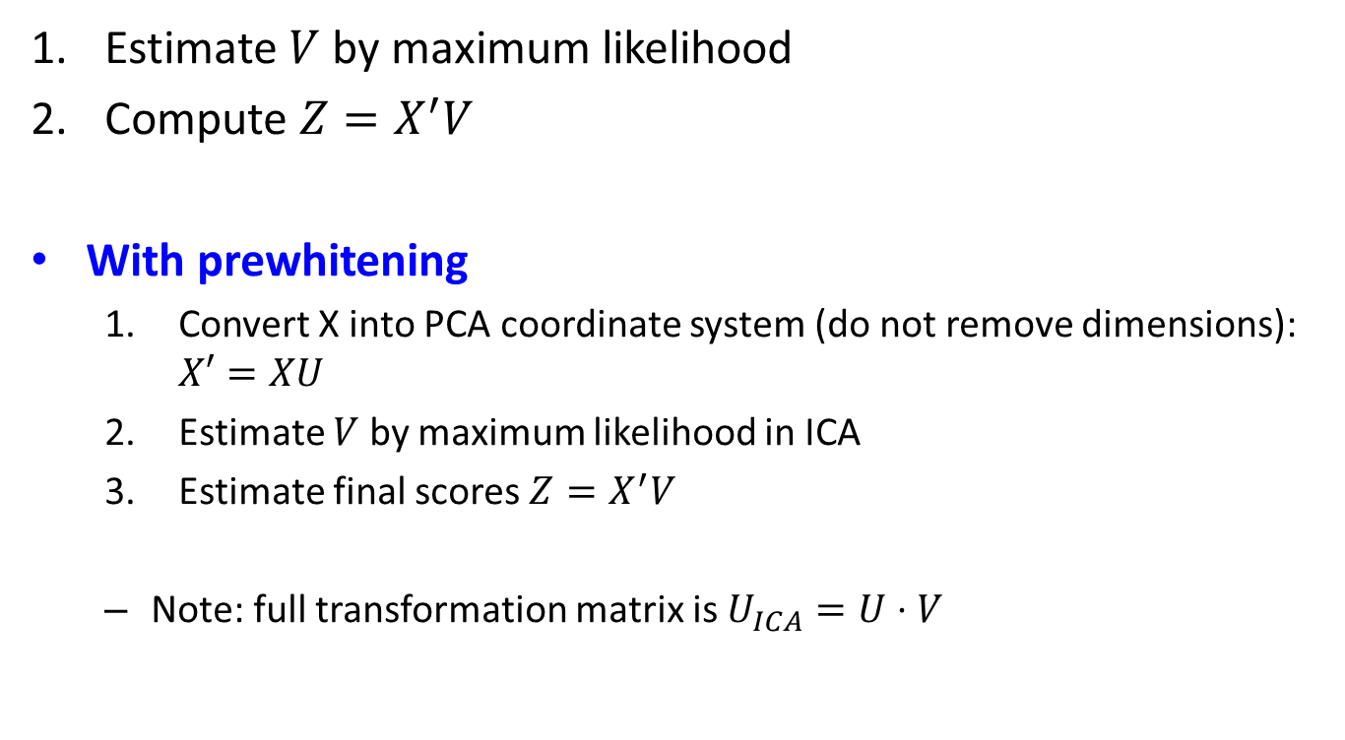
ICA: estimation algorithm
Estimate $V$ by maximum likelihood
Compute $Z=X^{′}V$
With prewhitening
Convert X into PCA coordinate system (do not remove dimensions): $X′=XU$
Estimate $V$ by maximum likelihood in ICA
Estimate final scores $Z=X^{′}V$
Note: full transformation matrix is $U_{ICA}=U⋅V$

Slide 31
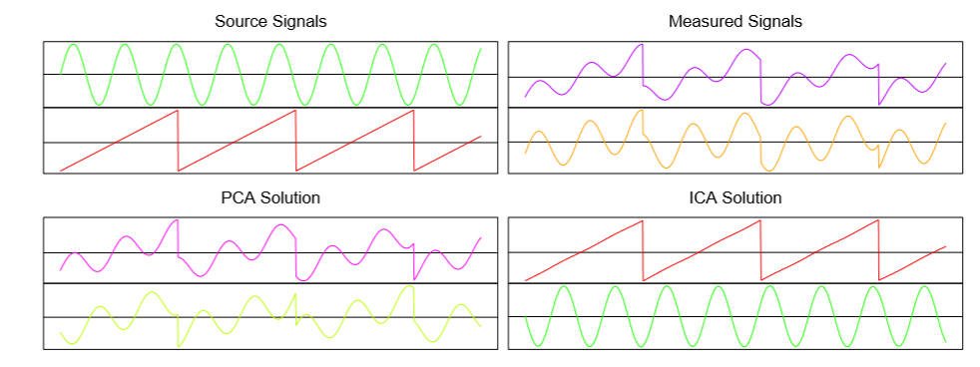
ICA
Example
Source: Elem of stat learn by Hastie

Slide 32
Independent component analysis: R
R package: fastICA
S <- cbind(sin((1:1000)/20), rep((((1:200)-100)/100), 5))
A <- matrix(c(0.291, 0.6557, -0.5439, 0.5572), 2, 2)
X <- S %*% A #mixing signals
a <- fastICA(X, 2) #now separate them

Slide 33

















Autoencoders (nonlinear PCA)
Why linear transformations? Take nonlinear instead!
$f()$ and $g()$ are typically Neural Networks
$${ x}_{1}$$
$${ \tilde{x}}_{1}$$
$${ x}_{2}$$
$${ z}_{1}$$
$${ \tilde{x}}_{2}$$
$${ x}_{3}$$
$$z=f(x,U)$$
$${ z}_{2}$$
$$\tilde{x}=g(z,R)$$
$${ \tilde{x}}_{3}$$
$${ x}_{4}$$
$${ \tilde{x}}_{4}$$
$$R^{p}$$
$$R^{M}, M<p$$
$$R^{p}$$
$$\min_{U,R}{\sum_{i=1}^{N}{{\left\|x_{n}−{\tilde{x}}_{n}\right\|}^{2}}}$$
…or some other loss function

